Slide 1
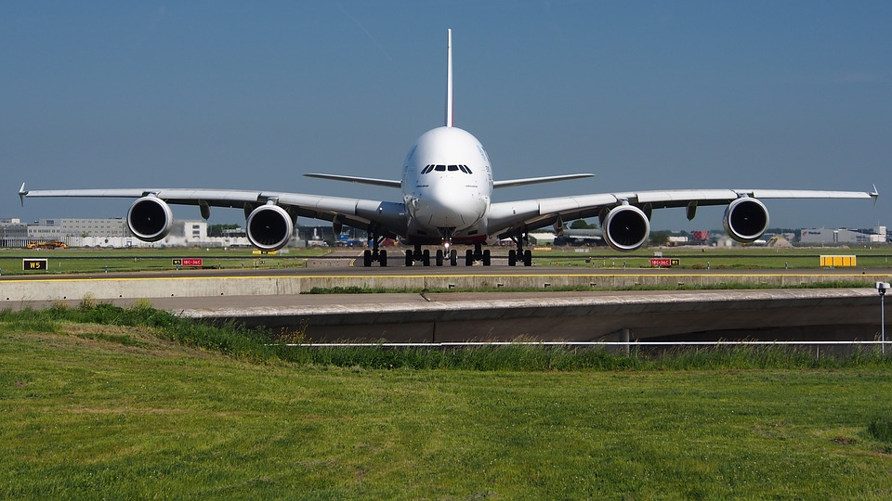
Unsupervised Analysis of Airline Sentiment on Twitter
By Patrick Miller & Ganesh Ramcharan

Slide 2

Problem Statement(s)
What are the most common complaints that customers have with the airport industry?
What are the chances of these issues resurfacing with different airlines?

Slide 3

What was contained in the data?
This Photo by Unknown Author is licensed under CC BY

Slide 4

Brief overview of the dataset
Our dataset, obtained from Kaggle.com, consists of over 14,000 tweets from February 2015 mentioning major US airlines. Stored in an SQLite database, it includes fifteen columns providing information about each tweet. The "airline_sentiment" column categorizes tweets as positive, negative, or neutral, while "airline_sentiment_confidence" measures confidence in the assigned sentiment label.

Slide 5
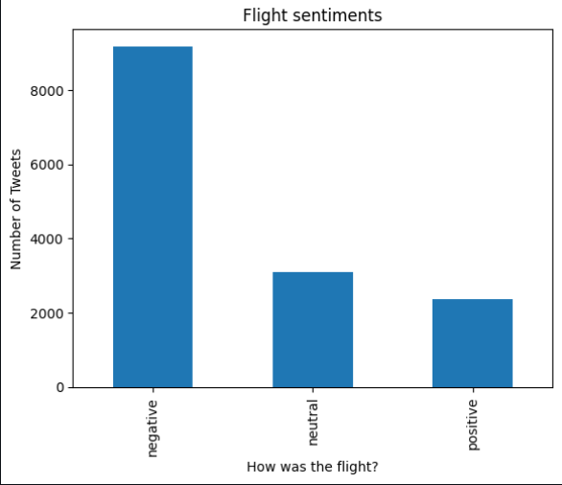
EDA/Data Cleaning/Preprocessing
To begin the exploratory data analysis (EDA) process, we first displayed the columns of the untouched data to get an overview of the available information. Then, we used the tweetsDf.head() function to display the first 5 rows and all 15 columns of the dataset.
Next, we filtered the data and selected the 'airline_sentiment' column to get the unique counts for each sentiment category (positive, negative, neutral). This allowed us to understand the distribution of sentiments in the dataset.

Slide 6
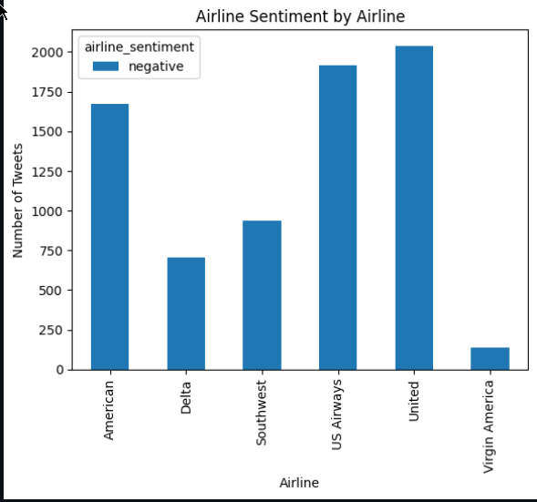
Afterwards, we focused specifically on the negative sentiments and selected the rows that corresponded to negative sentiment tweets. We further grouped the data by airline and sentiment to visualize the distribution of negative sentiments across different airlines using a histogram.

Slide 7
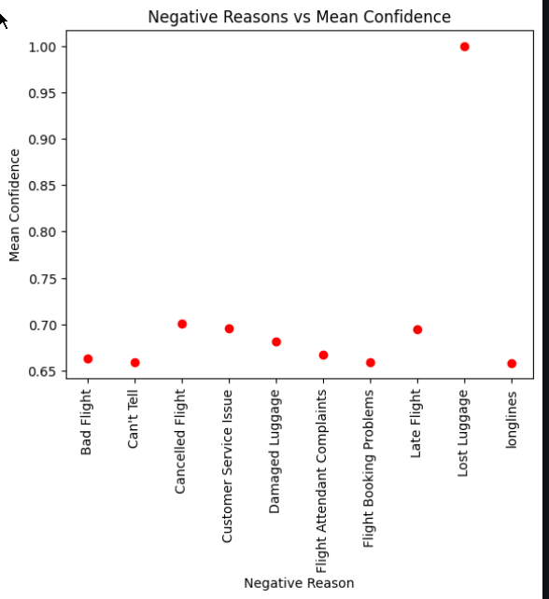
Moving on, we grouped the data by negative reason and computed the median confidence for each negative reason. This information was then displayed in a scatter plot, allowing us to analyze the relationship between the negative reasons and the confidence level in assigned sentiment labels.

Slide 8
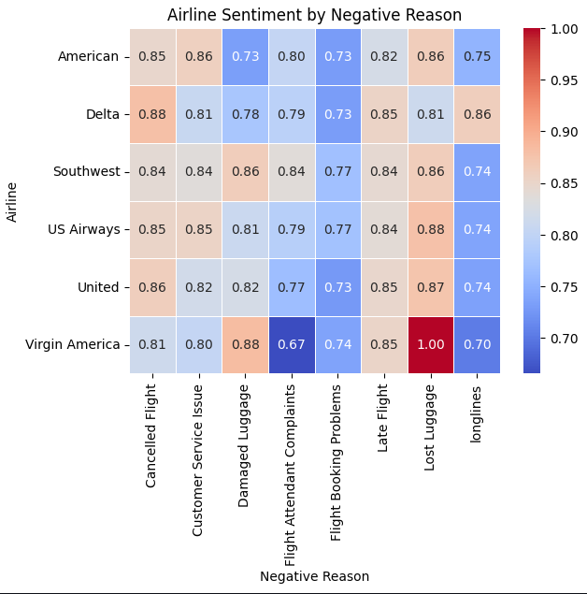
Our Heatmap

Slide 9
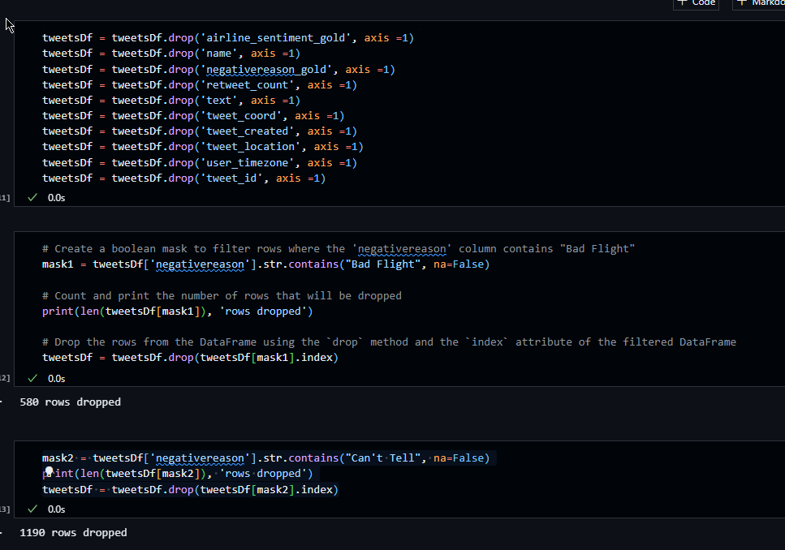
As part of the data cleaning process, we dropped the columns and rows that were not needed for our analysis. This helped streamline the dataset and remove unnecessary information. After making these changes, we displayed the dataframe again to observe the resulting modifications.

Slide 10
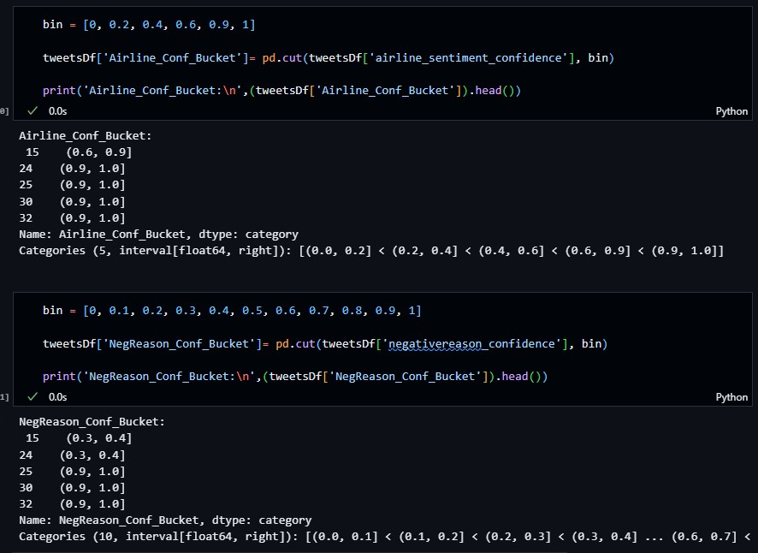
Next, we bucketized the cleaned data and displayed scatter plots and histograms to visualize the distributions of 'negativereason_confidence' and 'airline_sentiment_confidence'. These visualizations provided insights into the confidence levels associated with different negative reasons and sentiment labels.

Slide 11
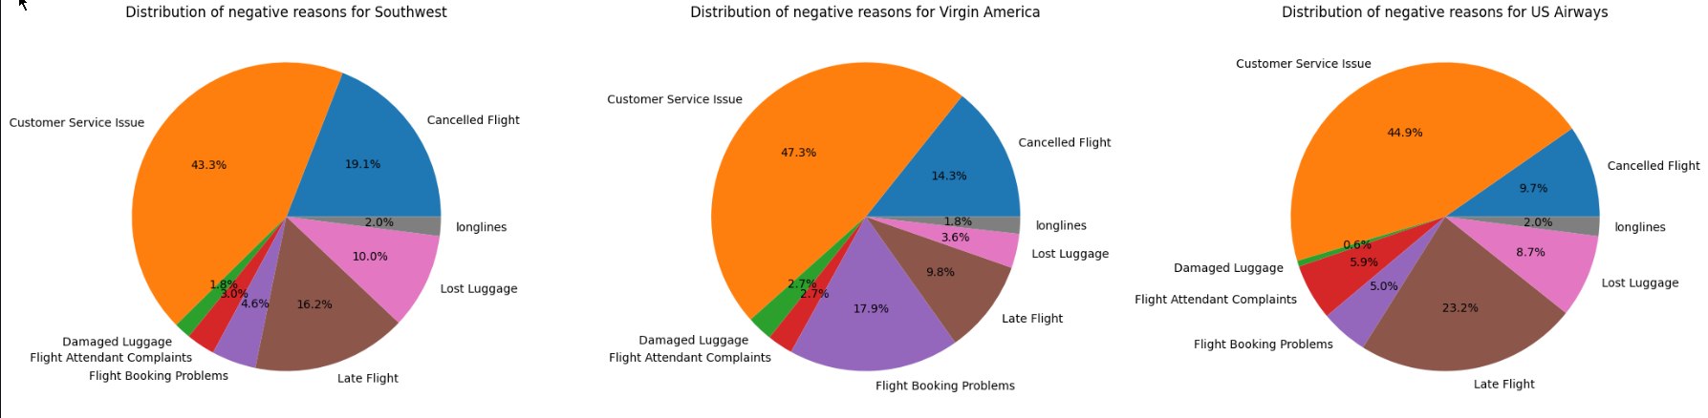
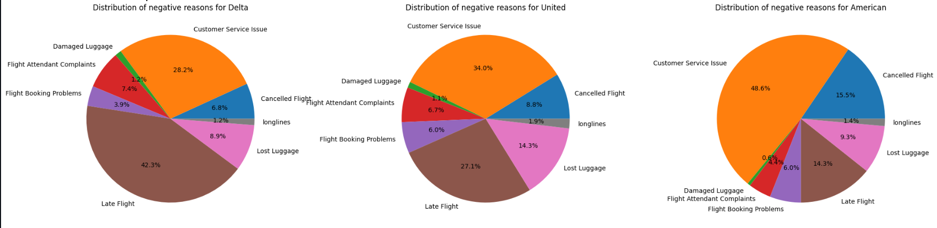
To provide a comprehensive view of the negative sentiments by airlines, we created six pie charts to display the distribution of negative reasons for each airline. This allowed for a visual comparison of the prevalent issues faced by different airlines.

Slide 12
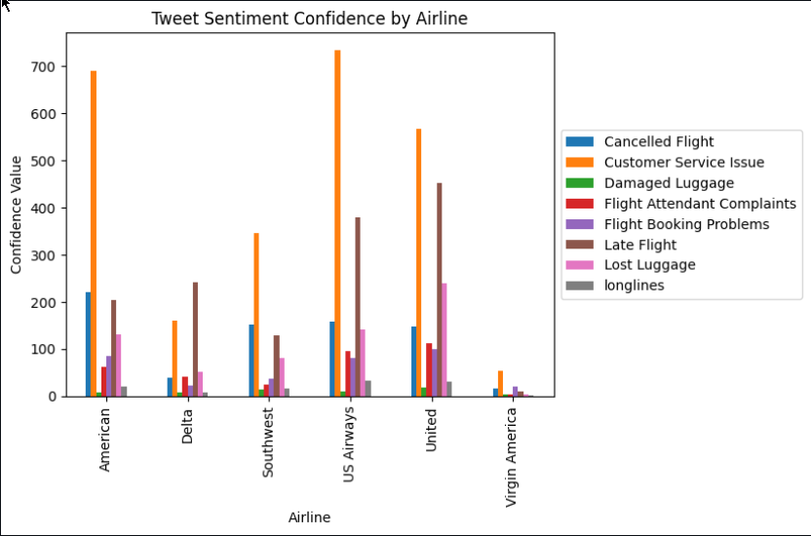
Additionally, we displayed a histogram of all the tweets to identify the most frequent negative reasons based on 'negativereason_confidence'. This helped us understand which issues were more commonly mentioned in the dataset

Slide 13
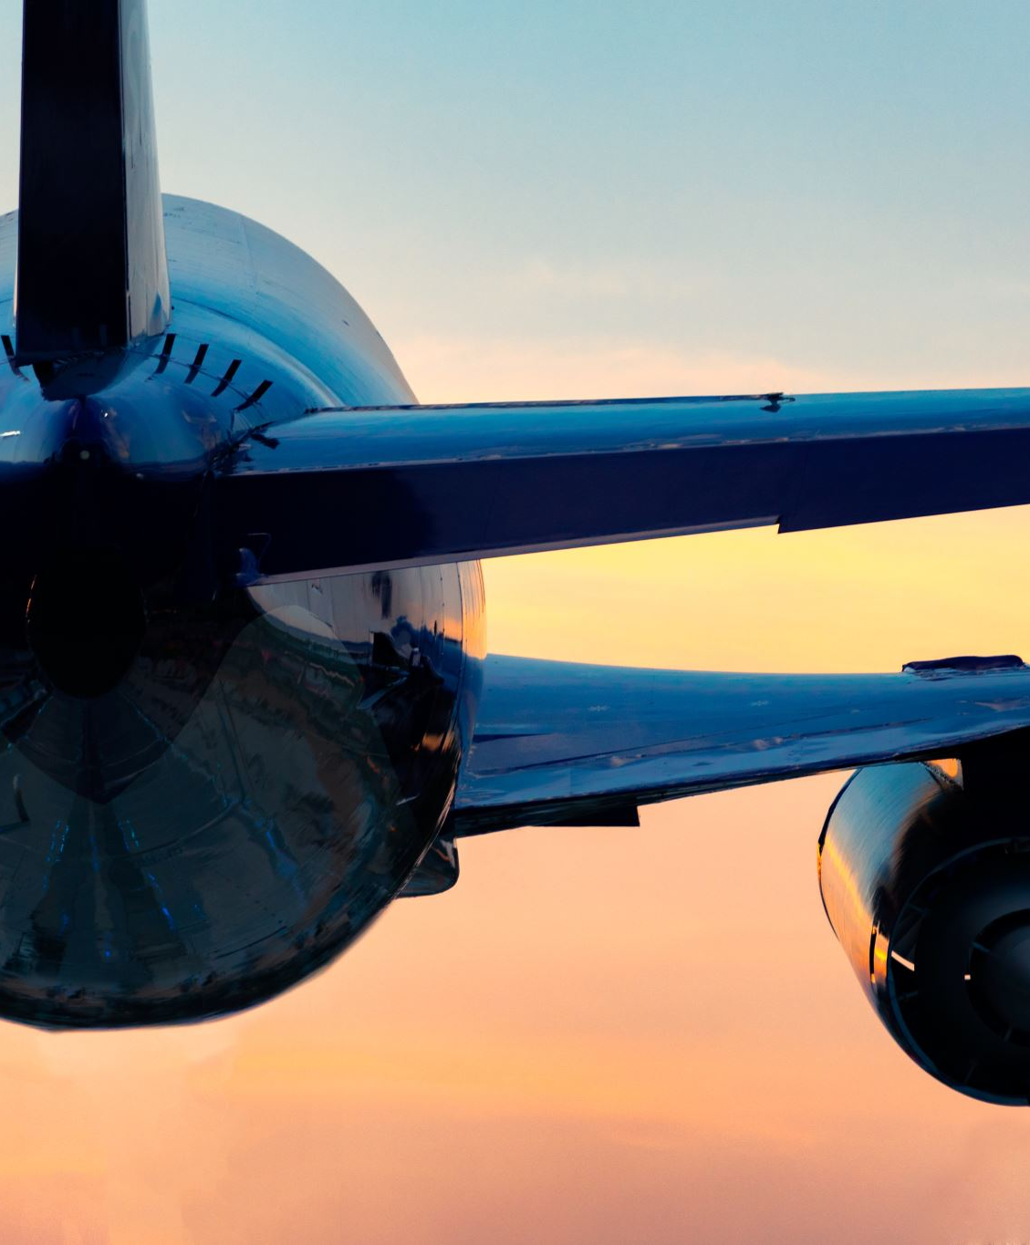
What algorithms did we use?
In the data modeling phase, we employed various clustering and classification algorithms to analyze the sentiment data. For clustering, we utilized K-means, Agglomerative Clustering, and DBSCAN algorithms, focusing on the 'negativereason_confidence' and 'airline_sentiment_confidence' columns. The evaluation of these clustering algorithms was based on metrics such as the Silhouette Score, Calinski-Harabasz Score, and Davies-Bouldin Index.

Slide 14
Quick Definitions
The Silhouette Score measures how well each data point fits its assigned cluster and ranges from -1 to 1, where a higher score indicates better clustering.
Calinski-Harabasz is a clustering evaluation metric that measures the ratio between the within-cluster dispersion and the between-cluster dispersion. The metric compares the variance between the clusters to the variance within the clusters and seeks to maximize the former while minimizing the latter. A higher Calinski-Harabasz score indicates a better clustering performance, meaning that the clusters are well-separated and compact.
The Davies-Bouldin index is a clustering validation metric that measures the average similarity between each cluster and its most similar cluster, compared to the distance between the clusters. It is defined as the ratio of the sum of the within-cluster distances to the between-cluster distances. A lower Davies-Bouldin index indicates better clustering, with a value of 0 indicating perfectly separated clusters. It is similar to the Calinski-Harabasz index but does not depend on the assumption of spherical clusters and is less sensitive to outliers.

Slide 15
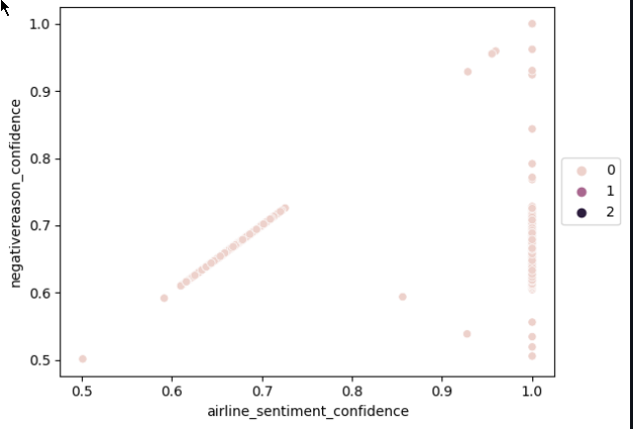
We utilized K-means clustering and Agglomerative clustering algorithms to group the data based on the columns 'negativereason_confidence' and 'airline_sentiment_confidence’.
Silhouette score: 0.38037570402412285
Calinski-Harabasz index: 8.959027968644058
Davies-Bouldin index: 0.37708544494911567

Slide 16
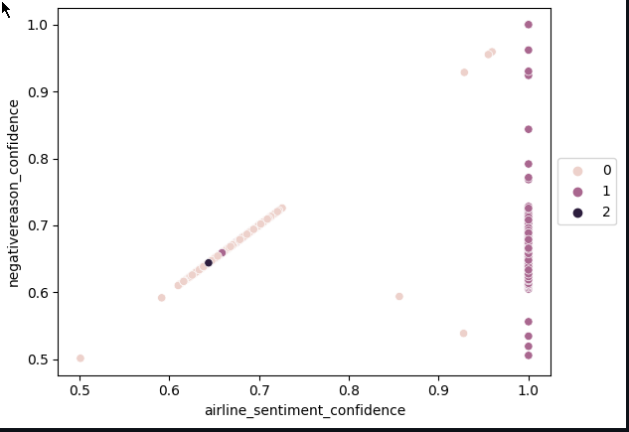
Agglomerative Clustering was applied to the negative sentiment dataset. The clustering analysis yielded moderate clustering quality, indicating that the algorithm was able to group similar negative sentiments together.
Calinski-Harabasz index: 10.706572091829083
Davies-Bouldin index: 11.834786944071963
Silhouette score: 0.5342796567233222

Slide 17
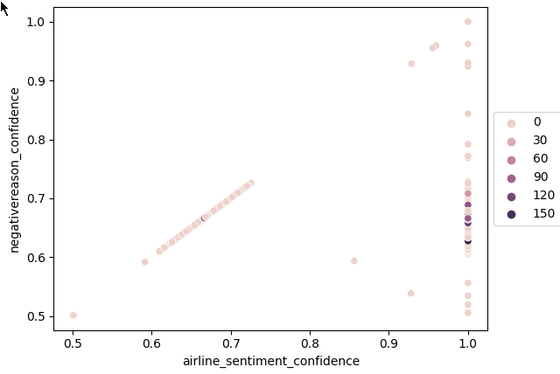
We utilized DBSCAN clustering algorithms to group the data based on the columns 'negativereason_confidence' and 'airline_sentiment_confidence’.
Silhouette score: 0.5342796567233222
Calinski-Harabasz index: 10.706572091829083
Davies-Bouldin index: 11.834786944071963

Slide 18

Discussion
By applying clustering algorithms, we gained insights into the common sentiment patterns in the airline industry.
Identified clusters associated with negative sentiments, including issues with customer service, late flights, and canceled flights.
These findings provide actionable insights for the airline industry, enabling improvements in customer service, punctuality, and flight cancellations.
The analysis helps in understanding trends and patterns in customer sentiment, allowing airlines to tailor their services and communication strategies accordingly.
Clustering algorithms provided a valuable approach to uncover sentiment patterns, assisting in data-driven decision-making and improving customer satisfaction.
DBSCAN performed the best among the evaluated clustering models, capturing sentiment patterns effectively based on the Silhouette Score.
The insights gained from these clustering algorithms guide airlines in improving services and addressing customer concerns.

Slide 19
Problem statement(s)
What are the chances of these issues resurfacing with different airlines?
What are the most common complaints that customers have with the airport industry?
Customer Service issue is the most common issue with the airport industry. The next most common Issue is Late Flight, and cancelled flight.
The likelihood of these issues resurfacing with different airlines varies based on specific factors. While clustering algorithms identify common negative sentiment issues like customer service problems, late flights, and cancellations, their occurrence depends on individual airline practices.
Real-time monitoring and analysis of customer feedback and industry trends are necessary to assess chances accurately. Ongoing evaluation and improvement are vital to proactively address emerging concerns and enhance customer satisfaction. Leveraging clustering insights and monitoring customer sentiments can help mitigate the chances of these issues resurfacing and improve overall airline services.

Slide 20
Conclusion
Clustering analysis provided insights into common negative sentiments in the airline industry.
DBSCAN showed the best performance with higher Silhouette Score and lower Davies-Bouldin Index.
Identified issues: customer service problems, late flights, and canceled flights.
Future directions:
Refine sentiment analysis techniques.
Implement real-time monitoring for prompt response.
Improve social media engagement strategies.
Utilize predictive analytics for forecasting and issue mitigation.
Integrate sentiment analysis with other feedback channels.
These steps enhance competitiveness and customer satisfaction

Slide 21
References
Here is an updated reference list for your document that includes a reference to Microsoft Bing:
Real Python. (n.d.). K-Means Clustering in Python: A Practical Guide. Retrieved from https://realpython.com/k-means-clustering-python/
Great Learning. (n.d.). Multinomial Naive Bayes Explained. Retrieved from https://www.mygreatlearning.com/blog/multinomial-naive-bayes-explained/
W3Schools. (n.d.). Python Machine Learning Decision Tree. Retrieved from https://www.w3schools.com/python/python_ml_decision_tree.asp
CrowdFlower. (n.d.). Twitter US Airline Sentiment. Retrieved from https://www.kaggle.com/datasets/crowdflower/twitter-airline-sentiment
OpenAI Chat. (n.d.). OpenAI Chat. Retrieved from https://chat.openai.com/
Microsoft Bing. (n.d.). Microsoft Bing AI Chatbot. Retrieved from https://www.bing.com/

